Slide 1
Software security
Andrei Petrovski
( a.petrovski@rgu.ac.uk)
CM530– System Programming and Security

Slide 2
Overview
What is software security ?
Understanding the role that software plays
in providing security
as source of insecurity
Principles, methods & technologies to make software more secure
Practical experience with some of these
Typical threats & vulnerabilities in software, and how to avoid them

Slide 3
Introduction
Software plays a major role in providing security, and is a major source of security problems
Software security does not get much attention
In programming courses
Many future programmers have little training on software security
In software company’s goal

Slide 4
Software and Security
Security is about regulating access to assets
e.g., information or functionality
Software provides functionality
E.g., on-line exam results
This functionality comes with certain risks
E.g., what are risks of on-line exam results?
Privacy (score leakage); Modification
Software security is about managing these risks

Slide 5
Software and Security
Security is always a secondary concern
Primary goal of software is to provide functionalities or services
Managing associated risks is a derived/secondary concern
There is often a trade-off/conflict between
security
functionality & convenience
Security achievement is hard to evaluate when nothing bad happens

Slide 6
Intended Versus Implemented Software Behavior in Applications
Most security bugs lay in the areas of the figure beyond the circle, as side effects of normal application functionality
Source: Herbert H. Thompson, Security Innovation

Slide 7
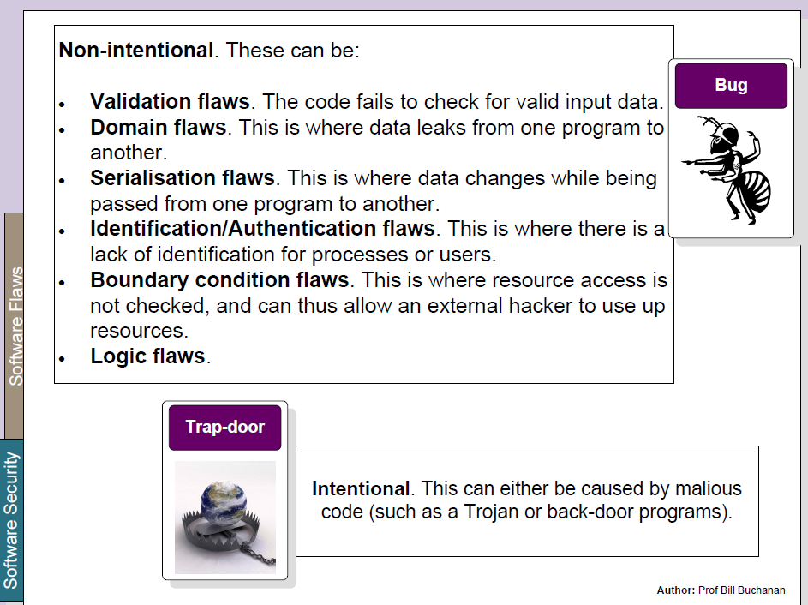
Software Flaws
© Prof. Bill Buchanan, http://asecuritysite.com/information/intro

Slide 8
Bad (insecure) Software

Slide 9
What is Bad Software?
Software that exposes confidential data to un-authenticate users
Software which crashes or grinds to a halt when exposed to faulty inputs
Software which allows an attacker to inject code and execute it
Software which executes privileged commands for an attacker

Slide 10
Software Insecurity
Networked Software is not designed to withstand a hostile environment
Development tools do not prevent simple security bugs (i.e., buffer overflows)
QA Testing methods do not address security
Customers pay for bad software
Notes:
First real programs were made only 50 years ago

Slide 11
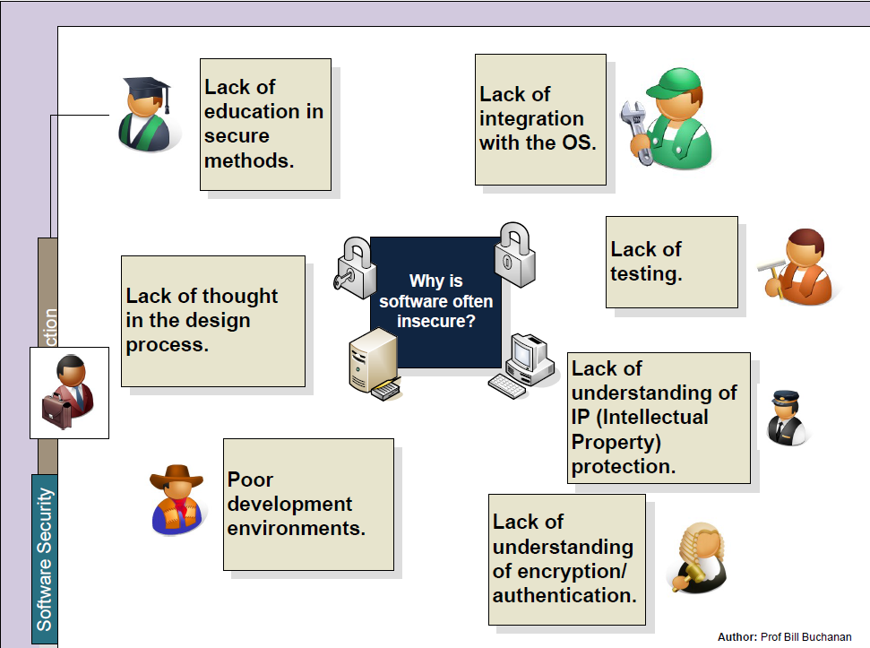
Software Insecurity
© Prof. Bill Buchanan, http://asecuritysite.com/information/intro

Slide 12
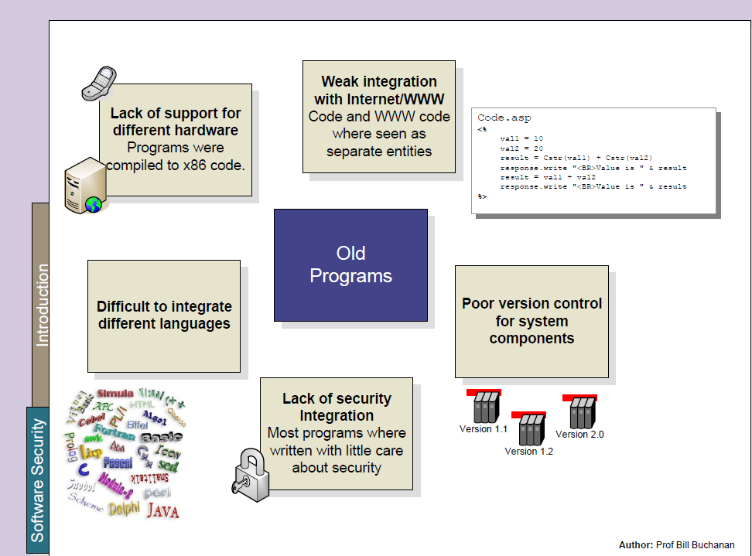
Software Insecurity (cont.)
© Prof. Bill Buchanan, http://asecuritysite.com/information/intro

Slide 13
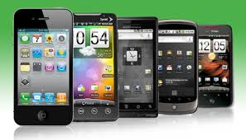
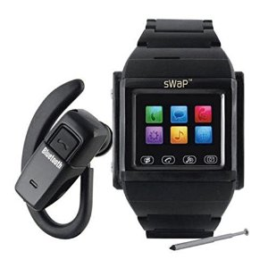
Getting Worse
In order to compete, new services must be delivered
New technology is not being properly tested for failures
More connections, devices, and code
What happens when buffer overflows and poor access controls lead to mobile code attacks on cellular phones?
Mobile code can effect distributed systems in a matter of hours

Slide 14
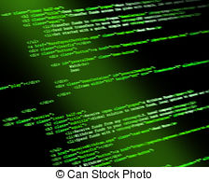
More Code
Technology is being ‘glued’ together
More feature rich, more drivers and libraries
In 1983, Microsoft word was only 27,000 LOC
Code Size
400,000 Solaris 7
17 million Netscape
40 million Space Station
10 million Space Shuttle
7 million Boeing 777
35 million NT5
Under 5 million Windows 95
1.5 million Linux
© Greg Hoglund – Cenzic, Inc., 2012
Notes:
Code Size

Slide 15
Security in the Development Cycle
Security Analysis in Development is a Risk Mitigation Strategy
You will not find all the bugs…
You will not see all the vulnerabilities…
Your design will have errors of omission and oversight

Slide 16
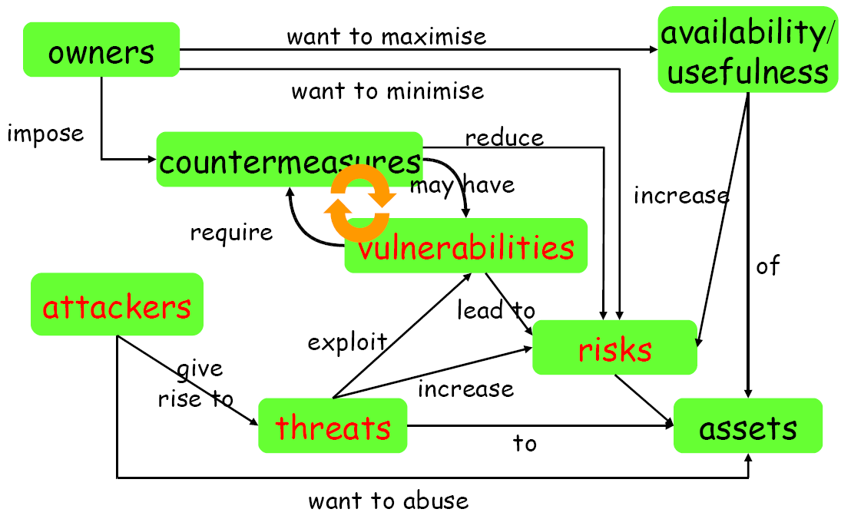
Security Concept
© Eric Pole – UCF, School of Electrical Engineering and Computer Science, 2008

Slide 17
Software Security assurance

Slide 18
Starting Point for Ensuring Security
Any discussion of security should start with an inventory of
the stakeholders (owners, companies…)
their assets (data, service, customer info…)
the threats to these assets (erase, steal…)
Attackers
employees, clients, script kiddies, criminals
Any discussion of security without understanding these issues is meaningless

Slide 19
Security Concepts
Security is about imposing countermeasures to reduce risks to assets to acceptable levels
“Perfect security” is not necessary and costly
A security policy is a specification of what security requirements/goals the countermeasures are intended to achieve
secure against what and from whom ?
Security mechanisms to enforce the policy
What actions we should take under an attack?

Slide 20
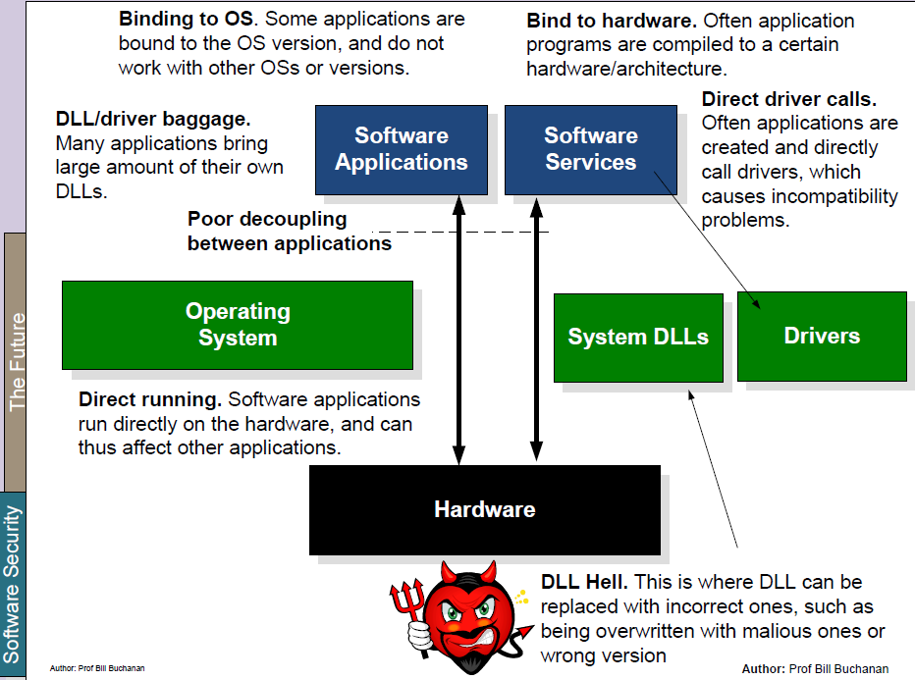
Current Status
© Prof. Bill Buchanan, http://asecuritysite.com/information/intro

Slide 21
Security Modeling – The Process
Define threats
Consider the data stored in the system, and how it can be misused
Consider the architecture of the system, and the opportunities it affords malicious users
Assess the Impact
You’ve found a vulnerability… what happens if someone actually finds it? How badly would you or your users be affected?
Implement a Countermeasure
Mitigate the risk to the best of your ability – code a preventative action, limit the exposure

Slide 22
Software Security
What are the methods and technologies, available to us if we want to provide security?
security in the software development lifecycle
engineering & design principles
security technologies
What are the methods and technologies available to the enemy who wants to break security ?
What are the threats and vulnerabilities we’re up against?
What are the resources and tools available to attackers?

Slide 23
Security in Software Development Life Cycle
Source: Gary McGraw, Software security, Security & Privacy Magazine, IEEE, Vol 2, No. 2, pp. 80-83, 2004.

Slide 24
Example Security Technologies
Cryptography
for threats related to insecure communication and storage
Covered in other modules
Access control
for threats related to misbehaving users
e.g., role-based access control
Language-based security
for threats related to misbehaving programs
typing, memory-safety
sandboxing
e.g., Java, .NET/C#

Slide 25
Example Security Technologies (cont.)
These technologies may be provided by the infrastructure/platform an application builds on,
networking infrastructure
which may e.g. use SSL
operating system or database system
providing e.g. access control
programming platform
for instance Java or .NET sandboxing
Of course, software in such infrastructures implementing security has to be secure

Slide 26
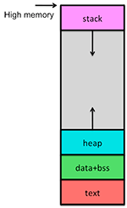
Software Infrastructure
Applications are built on top of "infrastructure" consisting of
operating system
programming language/platform/middleware
programming language itself
interface to CPU & RAM
libraries and APIs
interface to peripherals (socket, interrupt…)
provider of building blocks
other applications & utilities
e.g., database
This infrastructure provides security mechanisms, but is also a source of insecurity
Address space layout randomization (ASLR)
Data Execution Protection (DEP)
Control Flow Integrity (CFI)

Slide 27
Software Error Categories:
Insecure interaction between components:
Improper neutralisation of:
Special elements used in commands (OS commands, SQL commands, etc.)
Input during web page generation
Unrestricted upload of files
URL redirection to untrusted sites

Slide 28
Software Error Categories (cont.):
Risky resource management:
Buffer copy without size checking
Improper limitation of a pathname
Download code without integrity check
Inclusion of functionality from untrusted resources
Use of potentially dangerous functions
Incorrect calculation of buffer size
Uncontrolled format string
Integer overflow

Slide 29
Software Error Categories (cont.):
Porous defences:
Missing authentication for critical function
Missing authorisation
Use of hard coded credentials
Missing encryption of critical data
Reliance on untrusted inputs in security decisions
Execution with unnecessary privileges
Use of broken or risky crypto algorithms
Improper restrictions on authentication attempts

Slide 30
Handling Program Input
Input Size and Buffer Overflow
Interpretation of Program Input
Binary vs. text
Injection Flaws:
command injection (e.g. finger*)
SQL injection (SELECT * FROM … where …)
code, mail, format string, interpreter injection
Validating Input Syntax
regular expressions
ASCII, Unicode: encoding of “/” is “2F” and “”C0AF”
Input Fuzzing (randomly generated data)

Slide 31
Error Handling
Incomplete error handling which allows inappropriate data to bubble to an end user
Approaches
No unhandled exceptions
Use a recommended error handling policy
A transaction can be abused or overloaded in such a way as to render the system unusable – DoS attack
Approaches
Performance engineering during development

Slide 32
Writing Safe Program Code
Correct algorithm implementation
Ensuring that machine language correspond to algorithm (e.g. malicious compilers)
Correct interpretation of data values (e.g. data types)
Correct use of memory (excluding memory leaks)
Preventing race condition with shared memory – atomic operations

Slide 33
Interacting with the OS and other programs
Environmental variables (e.g. PATH)
Using appropriate, least privileges
avoid privilege escalation
System calls and standard library functions
e.g. secure deletion of a file
Preventing race conditions with shared system resources
Safe temporary file use

Slide 34
There’s More!
Unnecessary and Malicious Code
Broken Thread Safety and Concurrent Programming
Unauthorized Information Gathering
Accountability Problems and Weak Logging
Data Corruption
Broken Caching, Pooling, and Reuse

Slide 35
Improving Software Quality
If secure programming is hard, let’s build tools that make it easier to get security right
An approach: enforce defensive coding
Enumerate rules of prudent security coding
Use tools to automatically verify that software follows these rules

Slide 36
A High-Level View
Compile-time analysis of C source code
For developers:
Integrating Modelcheching Security Properties (MOPS) into build process catches bugs as soon as they are introduced
Think of MOPS like a type system
For auditors:
MOPS can analyze legacy code to help with code reviews of existing packages
A perfect match for open source

Slide 37
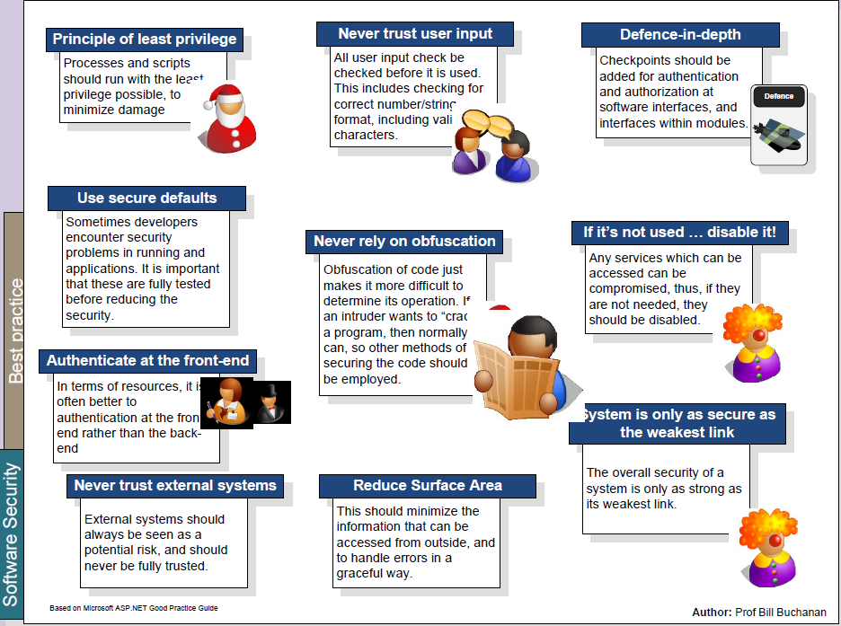
Software Security Best Practices
© Prof. Bill Buchanan, http://asecuritysite.com/information/intro

